Slide 1
AY 2023-2024 WORK ASSIGNMENT TEMPLATE (WAT)
Office of Vice Provost for Academic Excellence
Notes:
Feel free to change any “You will…” and “I will…” statements to ensure they align with your classroom procedures and rules!

Slide 2
Agenda
You will learn …
Purpose of WAT Access and Process Timeline WAT Platform New Template for AY 2023-2024 Section I Faculty Exemption Status Section II Assigned Workload

Slide 3
Work Assignment Template (WAT)
Purpose of the WAT
The work assignment template (WAT) is used to generate a UH System report mandated in Regents Policy 9.214 (III.E) WAT retroactively collects faculty work assignments the previous academic year 2023-2024. Work Assignment Credit Hours, reported in the WAT, reflect assigned time only. Qualitative and quantitative evaluation of individual faculty productivity is handled through contract renewal, tenure and promotion review, and periodic review processes.

Slide 4
Access & Process
Access | Process
WAT platform (data.hawaii.edu/wat) WAT Access: Excel file Check your access in WAT platform, and Excel file indicating who has access for respective units Edit if there has been change in roles/personnel in your unit: Viewers - Admin. Support Submitters - Dept. Chairs Reviewers - Deans/Assoc. Deans & Dirs Deadline: update Excel file by November 8, 2024 | Dept. Chair reviews to ensure all faculty are listed (Faculty with l< .10 FTE and lecturers do not show) Inform faculty of WAT access for their viewing Dept. Chair works with faculty to input workload assignments Dept. Chair reviews and submits to Dean/Associate Dean/Dir. Dean, Associate Dean, or Director approves and sends to OVPAE

Slide 5
WAT Timeline
Manoa Deadline: October 14, 2024 - WAT opens Units develop their own internal deadlines December 27, 2024 - Deans/Directors submit to OVPAE January 10, 2025 - OVPAE sends to IRAPO System Deadline: January 13 – February 27, 2025 – IRAPO collaborates with campuses to prepare BOR presentation February 28, 2025 – OVPAS submits to the President for review March 13, 2025 – President submits to BOR March 20, 2025 – OVPAS/officers present the WAT report to BOR

Slide 6
WAT Platform
Guide for using the WAT Platform
Note: depending on your specific role (e.g., Faculty Member or Department Chair) you may have a different view of the platform If the WAT link does not work, try to clear cache first and use Google Chrome. If needed, contact me at tamamiha@hawaii.edu, or 956-2508. Select AY 2023-2024, Click Search

Slide 7
Section I. Faculty Exemption Status

Slide 8
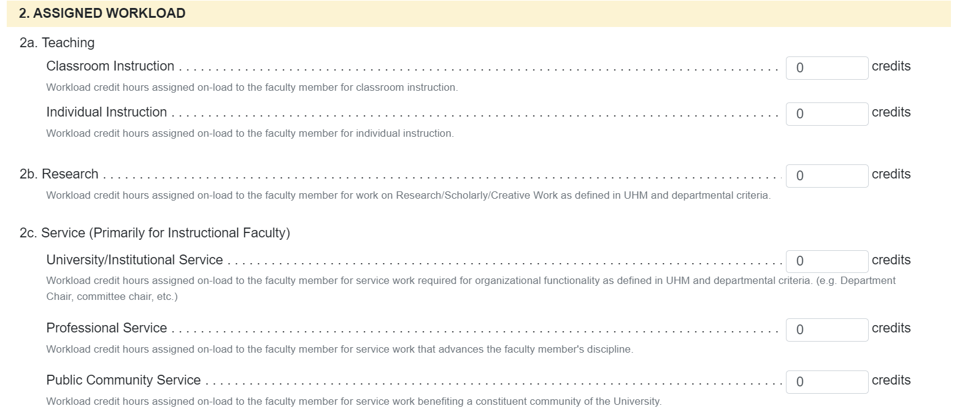
Section II. Assigned Workload for Instructional Faculty (I)

Slide 9
Section II. Assigned Workload for Instructional Faculty (I)(cont)
2a. Teaching | 2b. Research
Classroom Instruction: Workload credit hours assigned on-load to the faculty member for classroom instruction. Individual Instruction: Workload credit hours assigned on-load to the faculty member for individual instruction. | Workload credit hours assigned on-load to the faculty member for work on Research/Scholarly/Creative Work as defined in UHM and departmental criteria; reflective of unit workload policy.

Slide 10
Section II. Assigned Workload for Instructional Faculty (I)(cont)
2c. Service | 2d. Assigned Professional Duties
University/Institutional Service: Workload credit hours assigned on-load to the faculty member for service work required for organizational functionality as defined in UHM and departmental criteria. (e.g., Department Chair, committee chair, etc.). Professional Service: Workload credit hours assigned on-load to the faculty member for service work that advances the faculty member's discipline. Public Community Service: Workload credit hours assigned on-load to the faculty member for service work benefiting a constituent community of the University. | Not applicable for Instructional faculty. 2e. Release - not applicable for Manoa campus 2f. Buyout - not applicable for Manoa campus
Notes:
Unit criteria may define applicable service assignments; assignments should reflect unit workload policies

Slide 11
Section II. Assigned Workload for Instructional Faculty (I)(cont)

Slide 12
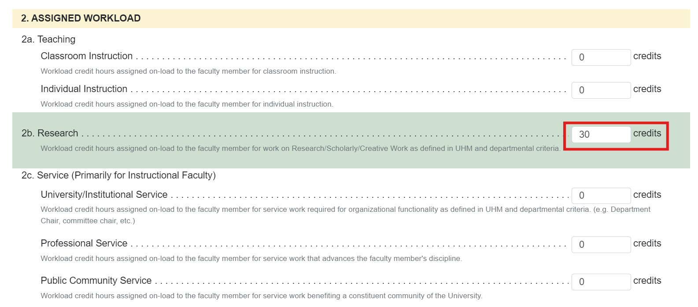
Section II. Default Workload for Researcher (R)

Slide 13
Section II. Assigned Workload for Researcher (R)
2b. Research (Default) Workload credit hours assigned on-load to the faculty member for work on Research/Scholarly/Creative Work as defined in UHM and departmental criteria. Teaching (2a) and Service (2c) assigned on-load reduces the default 30 credits in 2b.

Slide 14
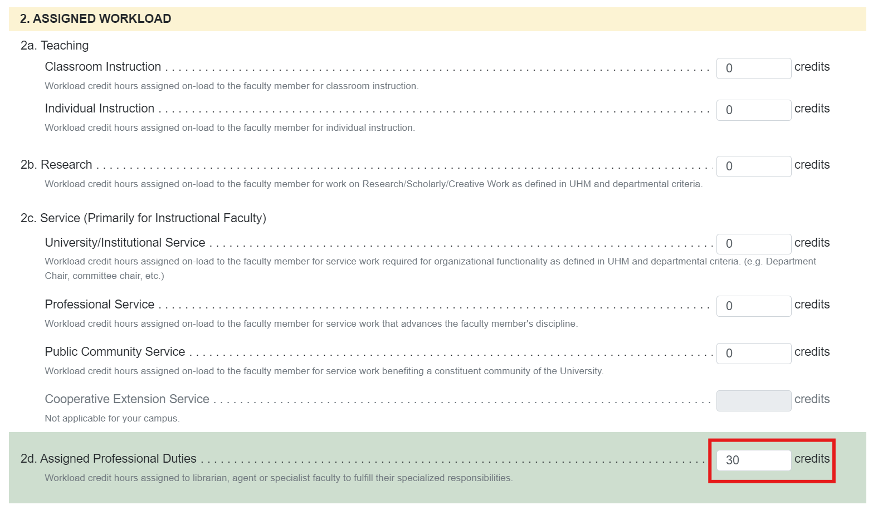
Section II. Default Workload for Extension Agent (A), & Specialist (S)
Notes:
UHM Librarians have not had to fill this out

Slide 15
Section II. Assigned Workload for Extension Agent (A), & Specialist (S)
2d. Assigned Professional Duties (Default) Workload credit hours assigned to librarian, agent or specialist faculty to fulfill their specialized responsibilities. Teaching (2a) or research (2b) assigned on-load reduces the default 30 credits in 2d.

Slide 16
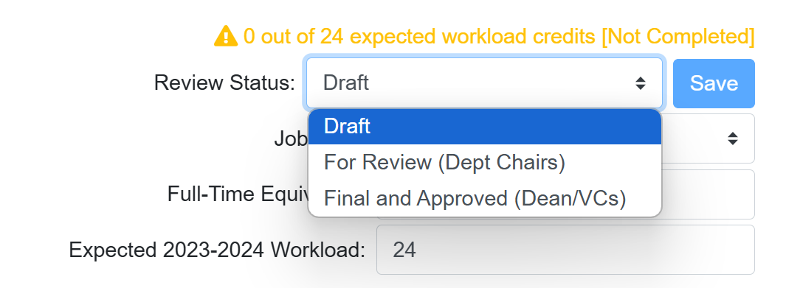
Supplemental Information
Saving Templates

Slide 17
Thank you!
Contacts:
Paul McKimmy Interim Associate Vice Provost for Academic Excellence (808) 956-9429 mckimmy@hawaii.edu Tamami Mohandie HR Specialist for Faculty Excellence (808) 956-2508 tamamiha@hawaii.edu

