Slide 1
1
02
07
01
04
06
05
03
AY 2022-2023
08
2
Work Assignment Template (WAT)
Agenda
3
Access, Process & Timeline
Instructional Faculty
Work Assignment Template (WAT)
SpecialistFaculty
Research Faculty
Supplemental Information
WAT Platform
Guide for Instructional Faculty
Overview of what we
will be covering today
Guide for Specailist Faculty
Guide for Research Faculty
4
Things to take note of
Guide in utilizing the WAT Platform
Provide you links and next steps with deadlines for Manoa and System
Covering the purpose of WAT
and what it will be used for
5
6
7
Office of the Vice Provost for Academic Excellence
8

Slide 2
1
02
07
01
04
06
05
03
08
Purpose of WAT and what it will be used for
Access, Process, Timeline
Changes in WAT
WAT Platform
Instruction – Section II
Non-Instruction – Section III
Supplemental Information
2
3
Agenda
Access, Process & Timeline
Instructional Faculty
SpecialistFaculty
Research Faculty
Supplemental Information
WAT Platform
Guide for Instructional Faculty
Guide for Specailist Faculty
Overview of what we
will be covering today
Guide for Research Faculty
4
Things to take note of
Guide in utilizing the WAT Platform
Provide you links and next steps with deadlines for Manoa and System
5
6
7
8

Slide 3
1
The work assignment template (WAT) is an annual collection of data on faculty members’ assigned time for the previous academic year. An aggregated annual report is made to the Board of Regents. Assigned credit hours and non-instructional equivalencies are reported
“The Work Assignment Credit Hours, reported in aggregate form in the WAT, reflect assigned time only. Qualitative evaluation of individual faculty work performed is handled through contract renewal, tenure and promotion review, and periodic review processes. Work assignment equivalencies should be used by departments, schools and colleges to develop workload policy and to guide chairs’ assignment of workload prospectively.”
Differentiate: Assigned WCH vs. assessment of productivity
Example
A faculty member with a “2/2” load may have had 12 credits of instruction, 9 credits (equivalencies) of research, and 3 credits (equivalencies) of service assigned.
07
01
02
04
06
05
03
08
2
Agenda
3
Access, Process & Timeline
Work Assignment Template (WAT)
Instructional Faculty
SpecialistFaculty
Research Faculty
Supplemental Information
WAT Platform
Guide for Instructional Faculty
Guide for Specailist Faculty
Guide for Research Faculty
4
Things to take note of
Guide in utilizing the WAT Platform
Overview of what we
will be covering today
Provide you links and next steps with deadlines for Manoa and System
Covering the purpose of WAT
and what it will be used for
5
6
7
8

Slide 4
1
02
03
Access
Excel sheet - this will allow you to see who currently has access and allows for you to edit if there has been change in roles/personnel
Process
Dept Chair reviews templates to ensure all faculty are listed (those with less than .10 FTE and lecturers will not show up)
Dept Chair reviews and submits to Dean
Timeline
WAT opens Sept 6, 2023
Dean approves and sends to OVPAE
Inform Faculty of WAT access for their viewing
Dept Chair works with Faculty to input information
Deans/Directors submit to OVPAE by Nov. 17, 2023
OVPAE sends to IRAPO by Nov. 22, 2023
IRAPO submits to BOR by January
WAT Link
data.hawaii.edu/wat/#/
Unit’s develop their own internal deadlines
07
01
04
06
05
08
2
Agenda
Access, Process & Timeline
3
Instructional Faculty
SpecialistFaculty
Research Faculty
Supplemental Information
WAT Platform
Guide for Instructional Faculty
Overview of what we
will be covering today
Guide for Specailist Faculty
Guide for Research Faculty
4
Things to take note of
Guide in utilizing the WAT Platform
Provide you links and next steps with deadlines for Mānoa and System
5
6
7
8

Slide 5
1
Reference Guide
02
07
04
01
06
05
08
Found under the FAQ’s tab in the WAT Platform
2
Depending on your specific role (e.g., Faculty Member or Department Chair) you may have a different view in the platform
If the WAT link does not work, please try to clear cache first and use Google Chrome, if both do not work then contact me directly at voong@hawaii.edu
As this is a retroactive data collection, please make sure to select AY 2022-2023
If a faculty member has a joint position – both units will have access to the faculty memberʻs template – please verify what would fall under your purview.
3
Agenda
Instructional Faculty
SpecialistFaculty
Research Faculty
Supplemental Information
WAT Platform
Guide for Instructional Faculty
Overview of what we
will be covering today
Guide for Specailist Faculty
Guide for Research Faculty
4
Things to take note of
Guide on utilizing the WAT Platform
5
6
7
8

Slide 6
1
02
1. Excel sheet download (see pg. 9 of reference guide) but you can no longer upload batch submissions. Information can only be manually entered into the platform
2. New: there will be “on-screen” help as you navigate through the platform
3. The look of the platform has changed - all employment information is viewable on the left of the platform. This includes the template status (e.g., Draft, Review).
4. Changes were made in Section III - Non-Instructional – which we will go over on slide #8.
5. Icons – a green checkbox will appear if faculty member met their workload basis, a yellow triangle with exclamation mark can mean a few things: a) Faculty member’s template has not been reviewed yet, b) Faculty member’s template has validation errors, or c) Faculty member did not meet workload basis last academic year
6. Based on faculty feedback, Section IV now includes Overload-Instruction during the off-duty period
04
07
01
05
06
08
2
Agenda
3
Changes
SpecialistFaculty
Research Faculty
WAT Platform
Supplemental Information
Overview of what we
will be covering today
Guide for Specailist Faculty
Highlights major changes in the WAT platform from last year
Guide for Research Faculty
4
Guide on utilizing the WAT Platform
Things to take note of
5
6
7
8

Slide 7
1
Data is pulled from banner
Please verify the information with the faculty member, if changes are needed please modify and provide context to the changes in “Classroom TE Adjustment Justification”
Courses in a classroom setting and have set credit hours
Directed Studies, Thesis Research, Dissertation Research courses (typically ends in 99 or 00)
Credit Hours CANNOT be calculated as there is a range of credits- so must be manually entered under Individual Instruction
Overload at this juncture is specific to teaching AND during the on-duty period
XL stands for cross-listed course
Regs stands for number of registered students
Credit hours calculated based on what is being pulled from banner
02
06
07
03
01
04
08
05
2
Instruction Data
3
Instruction
Agenda
SpecialistFaculty
Supplemental Information
Guide for Specailist Faculty
Highlights on
Instruction: Section II
Overview of what we
will be covering today
Things to take note of
4
Classroom Data
5
6
7
Individual
Data
8

Slide 8
1
What ‘I’ Faculty see
02
01
07
03
04
08
05
2
What ‘R’ Faculty see
3
Agenda
Non-Instruction
What ‘S’ Faculty see
Supplemental Information
Overview of what we
will be covering today
Things to take note of
4
Highlights on Non-Instructional: Section III
What ‘A’ Faculty see
5
YOU WILL NOTICE:
1. R, S, and A faculty has their WE Credits auto-populated w/24
2. You will have to +Add a “Workload Equivalency” for other categories: Service, Research, Extension, Buy-out, Admin, Release, Fall/Spring sabbatical and Other
3. IRAPO added “Professional Activities” for S faculty from traditional Service efforts – please click on ? For definition of Professional Activities – This row is specific to S-Faculty
4. You will need to fill in the context under “Notes” for any modifications to WE Credits
6
7
8

Slide 9
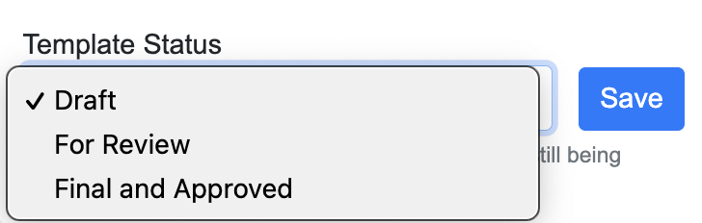
1
SAVING TEMPLATES
02
01
03
07
06
04
08
05
2
If the Dept Chair is still working on the template, save as [Draft]
If the Dept Chair is finished, save by selecting [For Review] and it will be forwarded to Dean/Associate Dean to finalize. Once saved [For Review], Dept Chair’s will no longer be able to edit.
If you are Dean/Associate Dean and you’ve reviewed and approve, select [Final and Approved] and click Save
If you are Dean/Associate Dean and additional information is needed you can select [Draft] then click Save to send it back to Dept Chair
3
Agenda
Supplemental
Information
Overview of what we
will be covering today
4
Things to take note of
5
Access
IRAPO is aware of the challenges some units have in how PeopleSoft limits sub-units
Section IV
Grant information was not able to auto-populate this year
Section III
We are aware of the extra effort it takes to add Workload Equivalency rows and will be working with IRAPO to have the rows for Research and Service be automatic
NEXT STEPS
6
7
8

Slide 10
FEEDBACK
This platform is a work-in-progress, if there are improvements to be made, please feel free to share them with me and I will take it to the table for discussion with the other campuses and IRAPO.
Thank
you!
Linda Voong
(808) 956-0291
voong@hawaii.edu
Paul McKimmy
(808) 956-9429
mckimmy@hawaii.edu

Slide 11
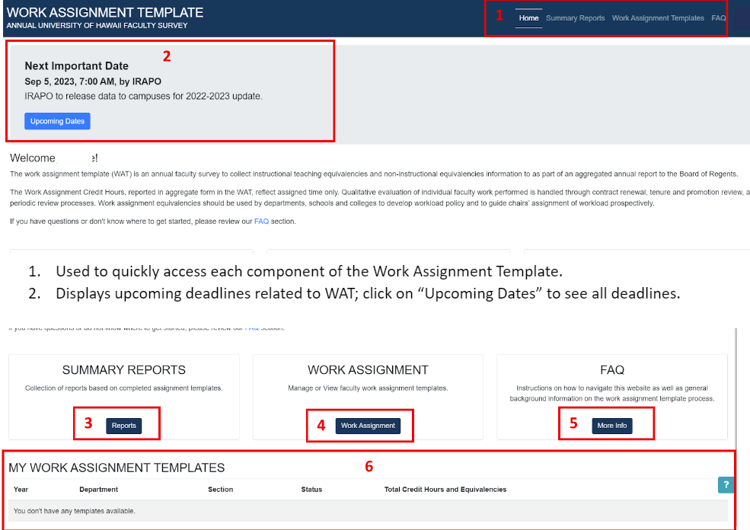
Department Chair’s View
The reference guide will highlight areas in red and provide definitions at the bottom of the page.
Faculty Member’s will only see 6

