Slide 1
Standard Setting Challenges
HARC – 2020 Conference
Christine Botosan, FASB Member

Slide 2
Technical Agenda Highlights
Conceptual Framework
Elements, Measurement, Presentation
Recognition and Measurement
Distinguishing Liabilities and Equity
Identifiable Intangible Assets and Subsequent Accounting for Goodwill
Improving the Accounting for Asset Acquisitions and Business Combinations
Reference Rate Reform Transition
Presentation and Disclosure Projects
Disclosure Review Projects – Income Taxes, Inventory, Interim, Government Assistance
Performance Reporting – Disaggregation and Segment Reporting
Simplifying the Balance Sheet Classification of Debt
NFP Reporting of Gifts in Kind
Research Projects
Disclosure Review – Intangibles, Share-based Payments, and Foreign Currency, Inventory and Cost of Sales, Hedge Accounting – Phase 2, Structure of the Performance Statement

Slide 3
Distinguishing Liabilities and Equity
What additional disclosures required?
✓
What types of claims are
liabilities? Equity?
FASB
X
How should changes in value be presented?
X
X
How measured?
Are all changes in value “income”?
X

Slide 4
FASB - Conceptual Framework Project
Bounds of the reporting entity
Element definitions
Bounds of the reporting entity
Measurement principles
Presentation principles
 | Elements | Measurement | Presentation
Goal | Refresh and update | Add concepts | Add concepts
Purpose | Strengthen certain definitions e.g. Asset, Liability… | Concepts to guide initial and subsequent measurement | Concepts to guide aggregation/ disaggregation
Status
Initial Deliberations
Initial Deliberations
Exposure Draft Redeliberation

Slide 5
Element Definitions
Definition of the
Reporting Entity
Measurement
Principle
Objective
Disclosure
Principle
Recognition
Principle
Presentation Principles –
Aggregation and Articulation
OTHER
FOUNDATIONAL ASSUMPTIONS

Slide 6
Foundational assumptions
Objective of Financial Reporting
Other Foundational Assumptions
A1: Going concern unless…
A2: Assets have definitional primacy
&
Information useful to resource providers in making resource allocation decisions
A3: Information is costly
A4: Resource providers care about E(cash flow)
A5: Relevance is primary
A6: E(cash flow) depend on
asset use

Slide 7
Economic philosophy of utility
Utility depends on how an object is used;
Utility is not innate to an object
Aristotle 384-322 BC, Adam Smith 1776, Tuttle 1891, etc.
Value-In-exchange:
Value-In-use:
The utility an object provides society
Not unique to the holder
The utility an object provides the individual
Unique to the holder
Utility_{holder} = Utility_{society}
Utility_{holder} ≠ Utility_{society}

Slide 8
Distinguishing types of assets
Value-In-exchange:
Value-In-use:
Utility is not unique to the holder
Utility is unique to the holder
Utility_{holder} = Utility_{society}
Utility_{holder} ≠ Utility_{society}
In-exchange Asset:
In-use Asset:
E(cash flow) not unique to the entity
E(cash flow) unique to the entity
E(cash flow)_{entity} = E(cash flow)_{market}
E(cash flow)_{entity} ≠ E(cash flow)_{market}
A6: E(cash flow) depends on asset use
A4: Resource providers care about E(cash flow)

Slide 9
What information helps?
Platinum used in production of catalytic converters
Platinum to be sold on the open market
What cash flows are resource providers trying to predict?
Implications for asset measurement?
Implications for role of balance sheet, income statement, cash flow statement?
Cash flows from sale
Cash flows from the production/sale of catalytic converters
Fair value
Historical cost
Balance sheet is King
All statements are Royalty
E(cash flow)_{entity} = E(cash flow)_{market}
E(cash flow)_{entity} ≠ E(cash flow)_{market}

Slide 10
Asset measurement & presentation
In-Exchange
E(cash flow)_{entity}
=
E(cash flow)_{market}
Fair Value
E (Cash Flow)
Resources
In-Use
E(cash flow)_{entity}
≠ E(cash flow)_{market}
Historical Cost
DESCRIBE
Income Statement – Accrual Basis | Statement of Cash Flow – Cash Basis
Cash generating unit *Disaggregation principles | Cash generating unit *Disaggregation principles
2. In-exchange assets | 2. In-exchange assets
3. Financing | 3. Financing
E (Cash Flow)
10

Slide 11
Valuation identity
VALUE CREATION
E(cash flow)_{entity}
VALUE DISTRIBUTION
E(cash flow)_{NRC} + E(cash flow)_{RC}
Value of the Entity = Value of Resources
Value of Claims on Resources
=
In-Exchange Assets
+
In-Use Assets
=
Nonresidual Claims
+
Residual
Claims
E(cash flow)_{entity}
=
E(cash flow)_{market}
E(cash flow)_{entity}
≠
E(cash flow)_{market}
Value_{entity} - Value_{NRC} = Value_{RC}

Slide 12
L&E measurement & presentation
Unrelated to Economic CI
Plug to Equity
Fair Value
Related to Economic CI
Comprehensive
Income
Nonresidual Claims
Claims
Amortized Cost
Disclose Fair Value
Upon Settlement
Residual Claims
Income Statement – Accrual Basis | Statement of Cash Flow – Cash Basis
Cash generating unit *Disaggregation principles | Cash generating unit *Disaggregation principles
2. In-exchange assets | 2. In-exchange assets
3. Financing | 3. Financing
Value Creation
Value Distribution

Slide 13
Interested in more?

Slide 14
Academic Programs
Objectives:
Increase the supply of relevant academic research
Improve FASB’s use of relevant academic research
Support efforts to help students understand FASB standards

Slide 15
Relevant Research
Society
Academy
FASB

Slide 16
For Example – ASU 2014-09… Revenue from Contracts with Customers
Objectives
More consistent and robust judgement and decision-making tool for addressing revenue recognition questions
Improve the comparability of revenue recognition practices across entities, industries, and capital markets
Provide more useful information to support better resource allocation decisions
Relevant research to help assess
Extent to which stated objectives are or are not accomplished
Extent of implementation and ongoing costs
Any unexpected economic consequences

Slide 17
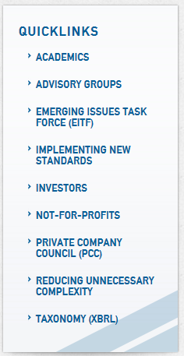
Academic Landing Page
https://www.fasb.org
https://www.fasb.org/academics
Mail to: academics@fasb.org

Slide 18
FASB Post-Doctoral Fellow
Responsibilities
Engage in project-specific research activities
Integrate identified research results into project analyses
Broadly educate Board and staff on nature and use of research
Liaise with the academic community
New PhD in Accounting (2 years or less), CPA desired but not required
Highly selective – one per year
49 applicants for 2020
Expect to announce 2020 Fellow in February/March
Michael Durney
FASB Post-Doctoral Fellow

Slide 19
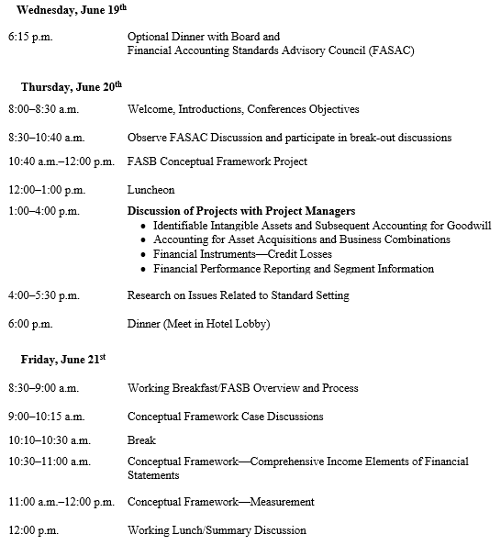
PhD Student/Faculty Summer Program
Summer 2019
Faculty Program
Summer 2020
PhD Student Program

Slide 20
Webinar for Accounting Educators
Introduced in 2018
2 Sessions:
Intermediate topics, several hours free CPE
Friday in August or September
Archived on the website and accessible via the academic landing page (via “What educational resources are available from the FASB?”)
Not-for-profit and governmental topics, several hours free CPE
Joint with the GASB
Friday in October or November

Slide 21
Thank You

Slide 22
Contact us: FASB
22
Keep up to date
Technical inquiries
@FAFNorwalk
FASB
FASBstandards
techinq@fasb.org
fasb.org/implementation
fasb.org/signup
(FASB Outlook, ActionAlert)
Join the organization, and help shape the future of financial reporting
fasb.org/careers

