Slide 1
Practices of Scientists
How scientists do the things they do

Slide 2
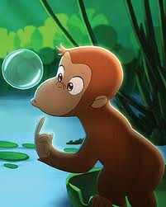
Curiosity
An emotion that leads to natural inquisitive behaviors like exploration and questioning. A desire to know new things.

Slide 3
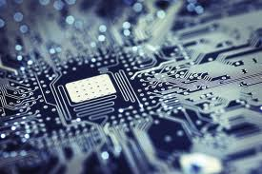
Technology
The making and testing of tools and techniques

Slide 4

Induction
Looking at existing data to find patterns and relationships

Slide 5

Replication
Duplicate something observed, heard about, or read. Test if something can be repeated.

Slide 6

Description
Carefully and accurately describing things or events.

Slide 7

Authoritative Knowledge
Consult books, websites, teachers, or peers who have expert knowledge.

Slide 8
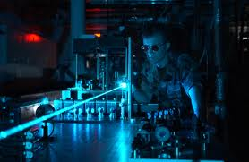
Experimentation
Testing your prediction or hypothesis.

Slide 9

Transitive Knowledge
Take knowledge from one field and apply it to another.

Slide 10

Product Evaluation
Weigh the pros and cons of different equipment, procedures, or products.

Slide 11
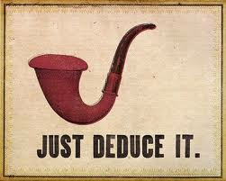
Deduction
Collect and analyze data (in a specific instance) to develop a hypothesis (a general statement)

