Slide 1
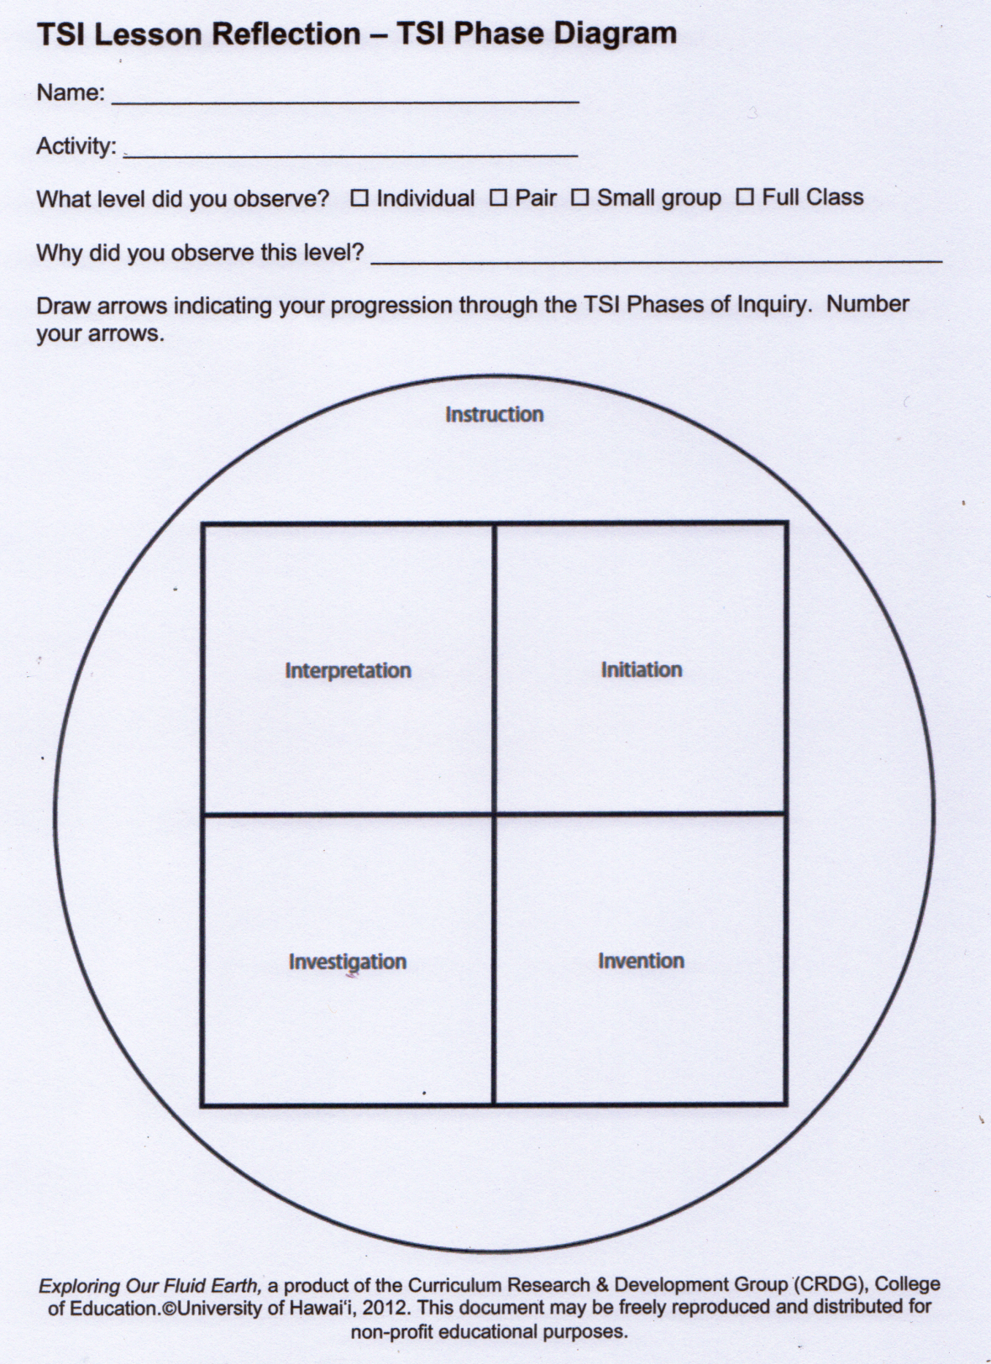
Anne McKnight
Density Bags
X
To observe different student approaches & pair dynamics (4 pairs )
2
22
23
21
1
3
20
19
16
15
12
11
4
5
6
7
8
9
14
13
18
17
10

